Slide 1
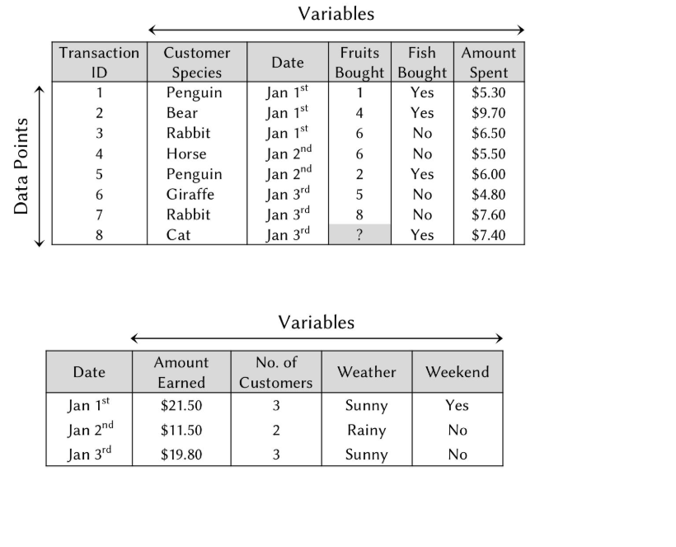

Slide 2
Variable types:
Binary
Categorical
Integer -whole number
Continuous - float
Variable selection
Feeding all features will produce
- slow computing
- poor prediction
Technique : Correlation

Slide 3
Feature engineering
Recode single variable - group values and derive new value on single column/variable
For multiple variables use – Dimensionality reduction (many columns to few columns for analysis)
Add meaning full columns/variables

Slide 4
Handle Missing data
Fill with Approximate values . .
Binary/categorical – use most common value
Integer/float – use median
Use algorithms to fill values
Example KNN
Hand made rules
- Use hand made rules or domain expert may help
Remove columns, rows

Slide 5
Algorithm selection and tuning
Understand problem
Choose algorithm which suits the problem – experience, domain knowledge, algorithm types, EDA, problem objective, Data type the algorithm that can handle, etc would help.
Many parameter exist for algorithms,
This is going to generate lot of models, so we need right model.
Parameter tuning (e.g tuning radio for the right frequency)
Hyper parameter
Model parameter

Slide 6
Overfitting
The model Works with training data, performing poorly for unseen data
Because it did less generalization
Underfitting
The opposite – did not learn all significant trends
Parameters tuned right then it handles the right balance between the above two.

Slide 7
Identify problem type

Slide 8
TEXT MULTI CLASS CLASSIFICATION
text | class
Toronto Feb 26 - Standard Trustco said it expects earnings in 1987 to increase at least 15... | earnings
New York Feb 26 - American Express Co remained silent on market rumors... | acquisition
BANGKOK March 25 - Vietnam will resettle 300000 people on state farms known as new economic... | coffee

Slide 9
NAMED ENTITIES
utterance | tag
Blade Runner is a 1982 neo-noir science fiction film directed by Ridley Scott | Movie Movie O O Date O O O O O O Person Person
Harrison Ford and Rutger Hauer starred in it | Person Person O Person person O O O
Philip Dick 's novel Do Androids Dream of Electric Sheep ? was published in 1968 | Person Person O O Book Book Book Book Book Book Book O O O Date

Slide 10
NATURAL LANGUAGE UNDERSTANDING (NLU), RASA - SAMPLE LIB
utterance | Intent (FUNCTIONS) | Slots (ARGUMENTS)
I want a pizza | order_food | O O O B-Food_type
Book a flight to Boston | book_flight | O O O O B-City
Book a flight at 7pm to London | book_flight | O O O O B-Departure_time O B-City

Slide 11
LANGUAGE TRANSLATION
text1 | text2
Hello! How are you doing? | Ciao, come stai?
I got promoted today | Oggi sono stato promosso!
Not doing well today | Oggi non mi sento bene

Slide 12
DIALOGUE MODELLING
user1 | user2
Hello! How are you doing? | Doing well, thanks!
I got promoted today | Congratulations!
Not doing well today | I’m sorry, can I do something to help you?

Slide 13
SENTIMENT ANALYSIS
review | sentiment
The movie was fantastic! | positive
Great acting and cinematography | positive
The acting was terrible! | negative

Slide 14
OBJECT IDENTIFICATION FROM IMAGE
image_path
images/image_000001.jpg | car
images/image_000002.jpg | dog
images/image_000003.jpg | boat

Slide 15
IMAGE CAPTIONING
image_path | caption
imagenet/image_000001.jpg | car driving on the street
imagenet/image_000002.jpg | dog barking at a cat
imagenet/image_000003.jpg | boat sailing in the ocean

Slide 16
IMAGE SIMILARITY
image_path_1 | image_path_2 | similarity
balinese/character01/0108_13.png | balinese/character01/0108_18.png | 1
balinese/character01/0108_13.png | balinese/character08/0115_12.png | 0
balinese/character01/0108_04.png | balinese/character01/0108_08.png | 1
balinese/character01/0108_11.png | balinese/character05/0112_02.png | 0

Slide 17
IMAGE QUESTION / ANSWERING
image_path | question | answer
imdata/image_000001.jpg | Is there snow on the mountains? | yes
imdata/image_000002.jpg | What color are the wheels | blue
imdata/image_000003.jpg | What kind of utensil is in the glass bowl | knife

Slide 18
SPEECH RECOGNISTION
audio_path | label
.../speech_recog_digit_data/recordings/0_jackson_0.wav | 0
.../speech_recog_digit_data/recordings/0_jackson_10.wav | 0
.../speech_recog_digit_data/recordings/0_jackson_11.wav | 0
... | ...
.../speech_recog_digit_data/recordings/1_jackson_0.wav | 1

Slide 19
AUDIO NUMEBERING
audio_path | label
audiodata/audio_000001.wav | 0
audiodata/audio_000002.wav | 0
audiodata/audio_000003.wav | 1
audiodata/audio_000004.wav | 1

Slide 20
BINARY CLASSIFCATION
Pclass | Sex | Age | SibSp | Parch | Fare | Survived | Embarked
3 | male | 22 | 1 | 0 | 7.2500 | 0 | S
1 | female | 38 | 1 | 0 | 71.2833 | 1 | C
3 | female | 26 | 0 | 0 | 7.9250 | 0 | S
3 | male | 35 | 0 | 0 | 8.0500 | 0 | S

Slide 21
TIME SERIES
Date time | Value
Dd/mm/yyy:hh:mm:ss | Xmxmxmxmxm
etc

Slide 22
REGRESSION, CLASSIFICATION
year | duration | nominations | categories | rating
1921 | 3240 | 0 | comedy drama | 8.4
1925 | 5700 | 1 | adventure comedy | 8.3
1927 | 9180 | 4 | drama comedy scifi | 8.4

Slide 23
MULTI LABEL CLASSIFICATION
image_path | tags
images/image_000001.jpg | car man
images/image_000002.jpg | happy dog tie
images/image_000003.jpg | boat water

Slide 24
NLP, SAMPLE LIB NAME NLTK STANFORD
sentence | chunks | part_of_speech | named_entities
San Francisco is very foggy | B-NP I-NP B-VP B-ADJP I-ADJP | NNP NNP VBZ RB JJ | B-Loc I-Loc O O O
My dog likes eating sausage | B-NP I-NP B-VP B-VP B-NP | PRP NN VBZ VBG NN | O O O O O
Brutus Killed Julius Caesar | B-NP B-VP B-NP I-NP | NNP VBD NNP NNP | B-Per O B-Per I-Per

Slide 25
REGRESSION
MPG | Cylinders | Displacement | Horsepower | Weight | Acceleration | ModelYear | Origin
18.0 | 8 | 307.0 | 130.0 | 3504.0 | 12.0 | 70 | 1
15.0 | 8 | 350.0 | 165.0 | 3693.0 | 11.5 | 70 | 1
18.0 | 8 | 318.0 | 150.0 | 3436.0 | 11.0 | 70 | 1
16.0 | 8 | 304.0 | 150.0 | 3433.0 | 12.0 | 70 | 1

Slide 26
BINARY CLASSIFICATION
transaction_id | card_id | customer_id | customer_zipcode | merchant_id | merchant_name | merchant_category | merchant_zipcode | merchant_country | transaction_amount | authorization_response_code | atm_network_xid | cvv_2_response_xflg | fraud_label
469483 | 9003 | 1085 | 23039 | 893 | Wright Group | 7917 | 91323 | GB | 1962 | C | C | N | 0
926515 | 9009 | 1001 | 32218 | 1011 | Mums Kitchen | 5813 | 10001 | US | 1643 | C | D | M | 1
730021 | 9064 | 1174 | 9165 | 916 | Keller | 7582 | 38332 | DE | 1184 | D | B | M | 0

